Slide 1
Toraberu – Requesting a Dispatch Step by Step
August 20, 2024
KHI Design & Technical Service, Inc.

Slide 2
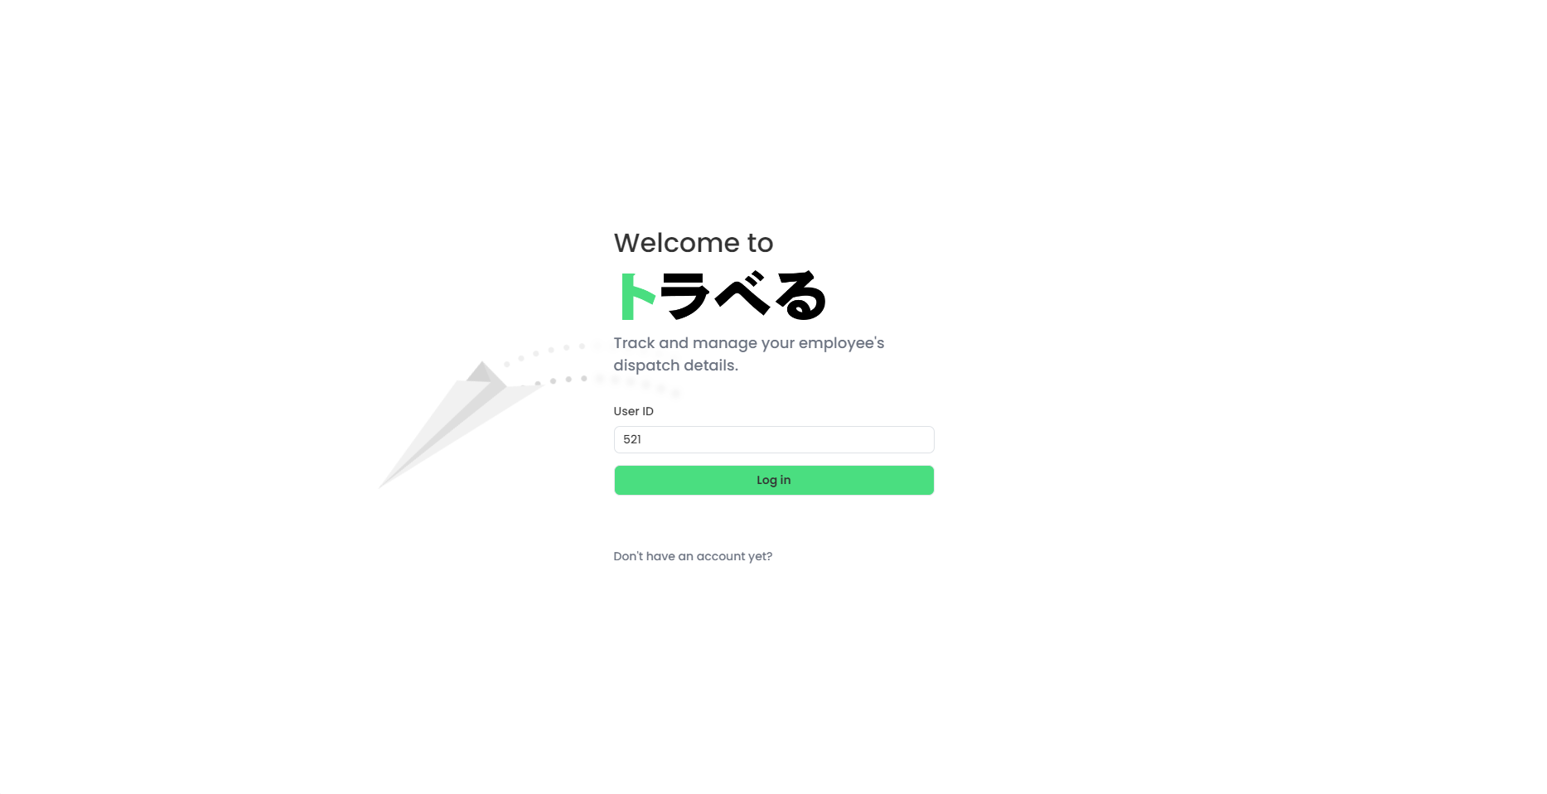
1. Login to the Toraberu Website using your Employee ID

Slide 3
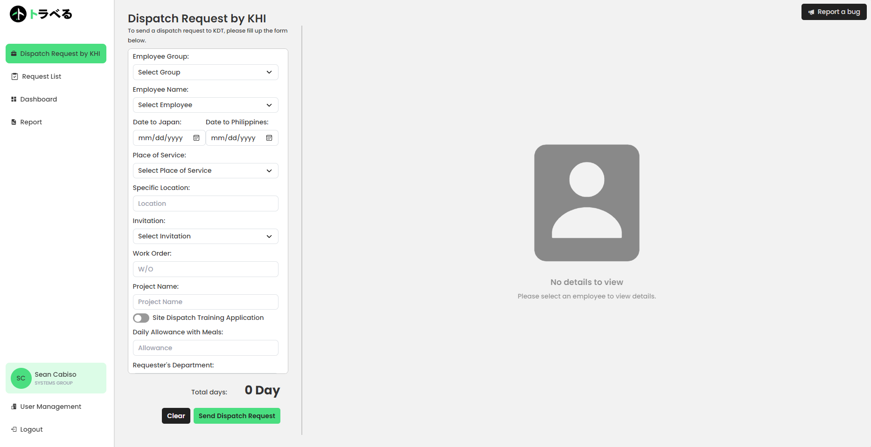
2. Click the Dispatch Request from the Dashboard
CLICK

Slide 4
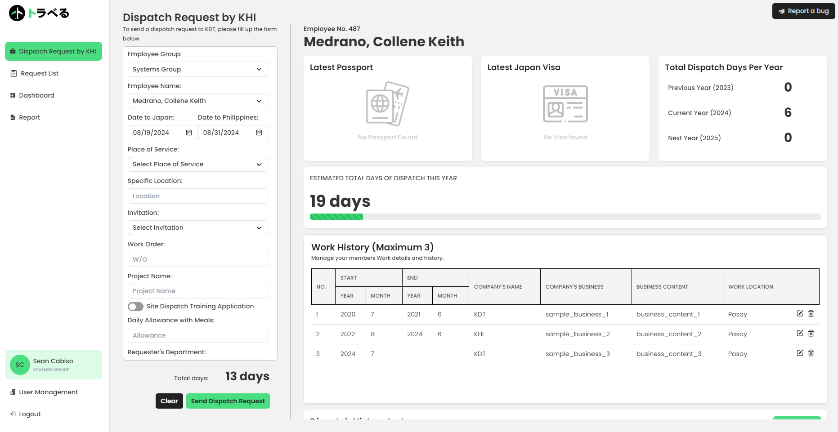
3. Fill out the Employee Information and check for their Documents
1
Fill out Employee Details and Date range of Dispatch
2
Check for Employee’s Documents
3
Check if the Employee is still within the range of available Dispatch Days (<183 Days)

Slide 5
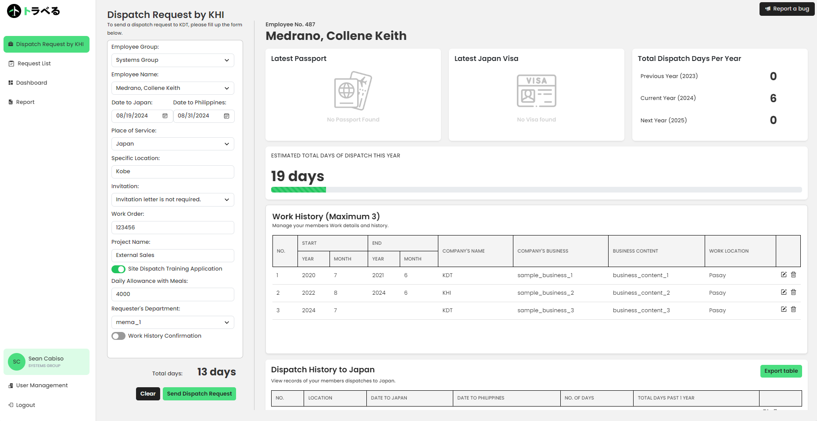
4. Fill out the remaining Information about the Dispatch
Fill out Dispatch Information

Slide 6

5. Send a Dispatch Request after confirming Employee’s Work History
1
Read and Check through the Employee’s Work History
2
Click on the checkbox after confirming the Work History
NOTE:
Only Click after reading and checking the checkbox above
3
Sends a Dispatch Request to KDT

Slide 7
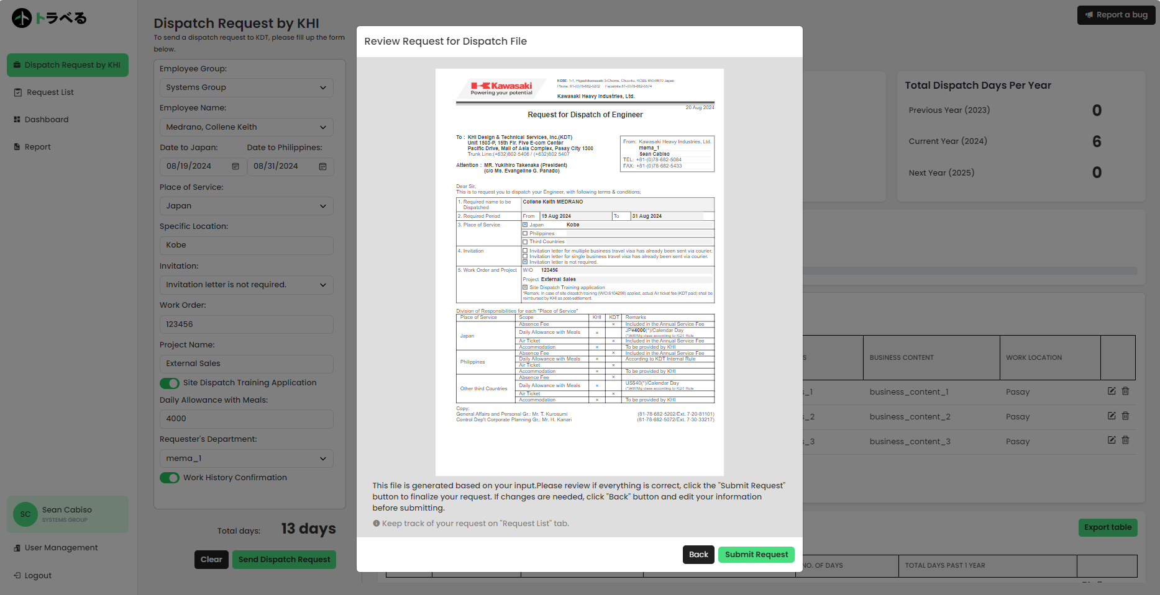
6. Review your Inputs from the Preview of the Dispatch Form
1
Review the Dispatch Form
Click to go back to the form
2
Click to Submit Dispatch Request after Reviewing

Slide 8
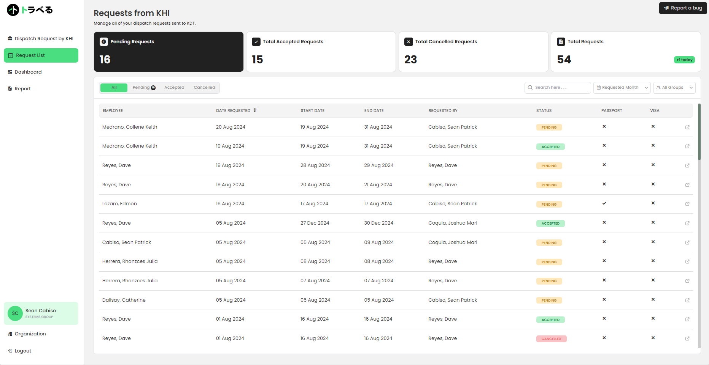
6.5. KHI can view Pending and Past Dispatch Requests in Request List
1
CLICK
2
KHI can click on a request from the list to view the Dispatch Details

Slide 9
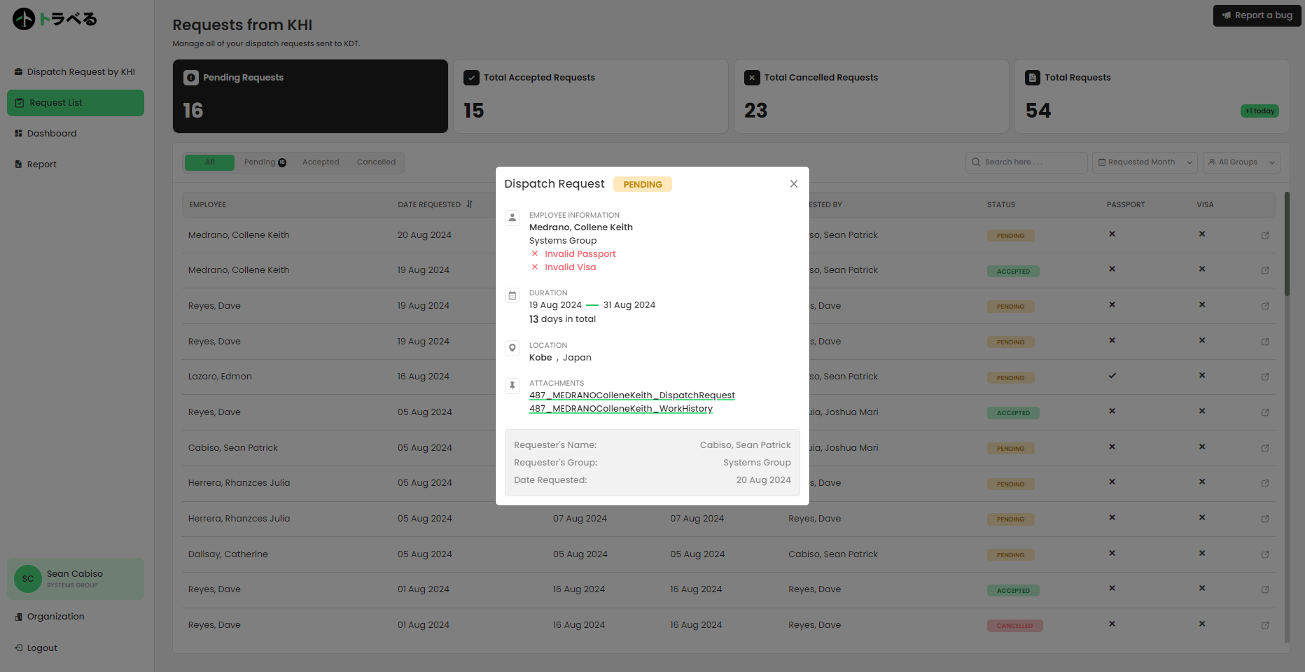
6.5. KHI can view Pending and Past Dispatch Requests in Request List
View the Dispatch Request Details here along with the Documents
NOTE:
The Documents inside the Request Modal can only be viewed and cannot be exported/printed

Slide 10
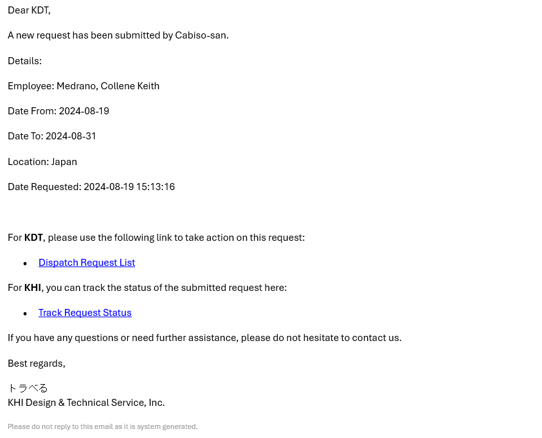
7. An Email will be sent to KDT President after Submitting a Dispatch Request
EMAIL RECIPIENTS
Email To : KDT President
Email CC :
KHI Admin
- HR
- Admin
KHI Group or Dept counter part of KDT Group
- KHI Manager
- KHI Person In Charge
- KHI Group Requestor
KDT Admin
- Admin DM / SM
- Soriano san
- Meriam san / Arlene san
KDT Group Leaders
- with designation SSV AM DM
Click by KDT President

Slide 11
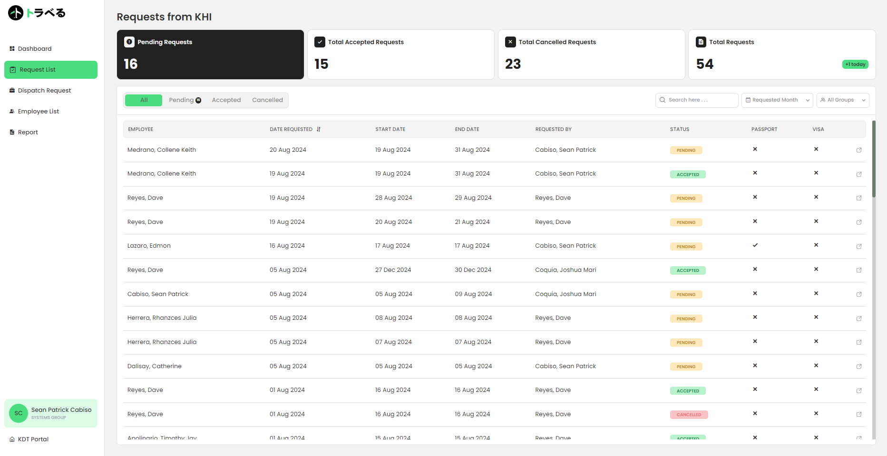
8. KDT President gets redirected to the Request List to view the Dispatch Request
1
CLICK
2
Click to view the Dispatch Request Details and Documents

Slide 12
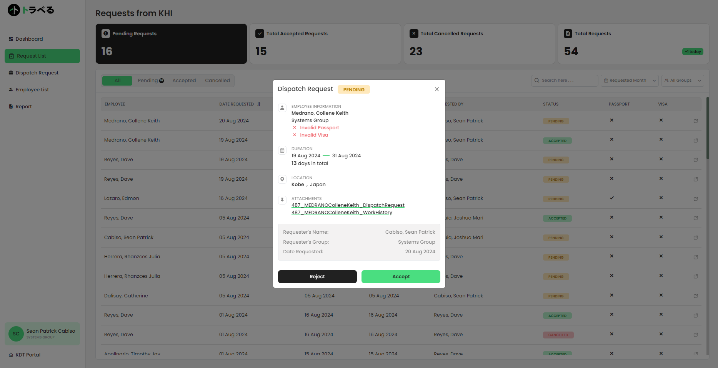
9. KDT President can Accept/Reject the Dispatch Request from KHI
Details of the Dispatch Request
Click to view the Documents (Printable)
Click to Reject Dispatch Request
NOTE:
Click to Accept Dispatch Request
The Documents inside the Request Modal can be printed

Slide 13

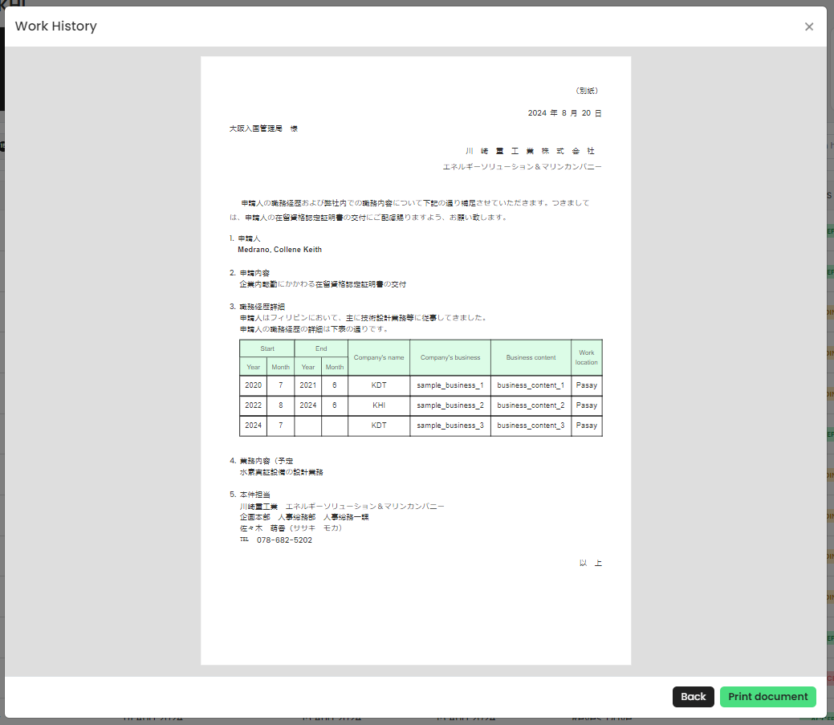
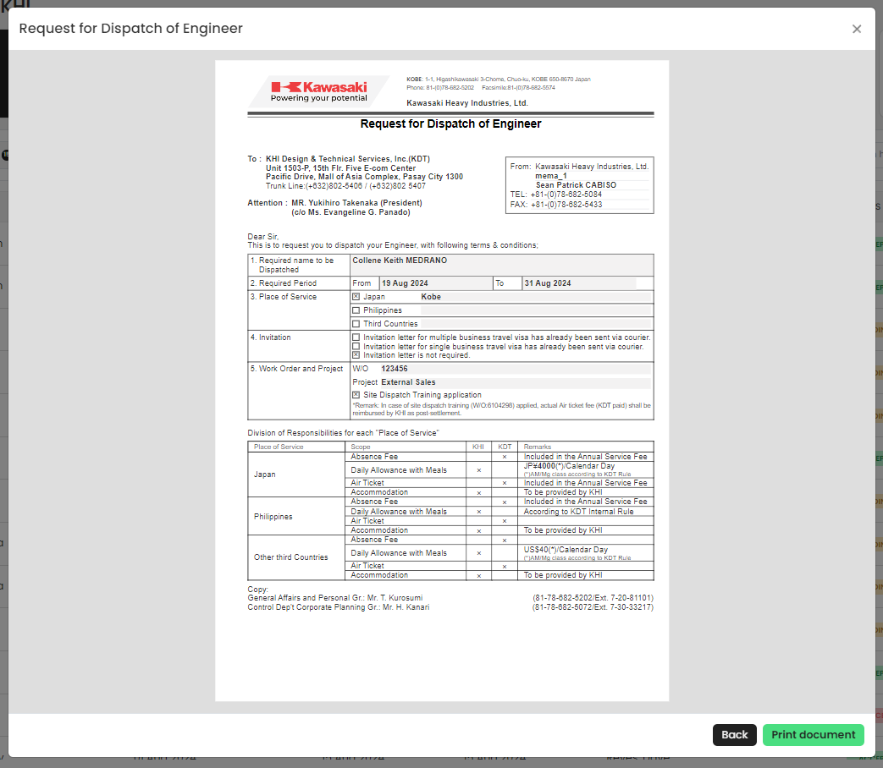
9.5. KDT President can also click on the attachments and view them
NOTE:
Viewed Attachments here are printable

Slide 14
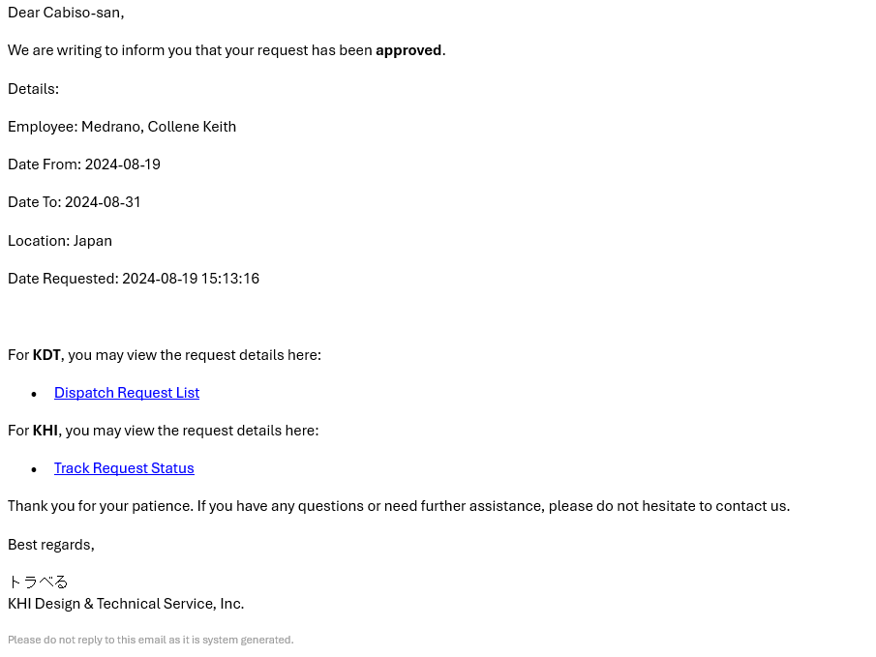
10. An Email will be sent to the Requester regarding their Dispatch Request after KDT President Clicked on Accept/Reject
EMAIL RECIPIENTS
Email To : KHI Group Requestor
Email CC :
KHI Admin
- HR
- Admin
KHI Group or Dept counter part of KDT Group
- KHI Manager
- KHI Person In Charge
- KHI Group Requestor
KDT Admin
- KDT President
- Admin DM / SM
- Soriano san
- Meriam san / Arlene san
KDT Group Leaders
- with designation SSV AM DM
Click by KDT Admin if Approved

Slide 15

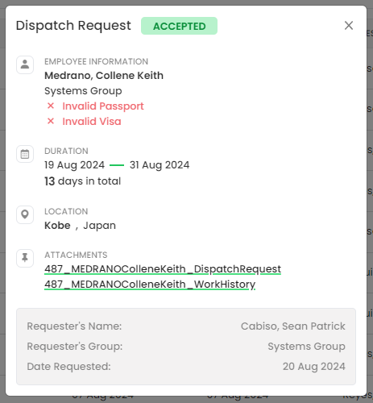
11. KDT Admin will be redirected to the Request List page and download the Documents for the Dispatch Request
1
NOTE:
CLICK
Only Accepted Dispatch Requests will be processed by KDT Admin
2
Click to View Dispatch Request
3
KDT Admin will download and process the Employee’s Documents

Slide 16
12. KDT Admin will also create an Email with the necessary documents attached that will be sent to KHI HR/Admin
Email from KDT Admin (with Attachment of Employee’s Document) to KHI HR/Admin

Slide 17



